Slide 1
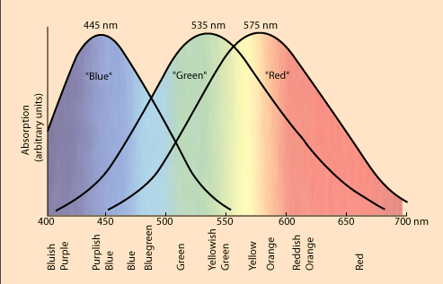
Color Sensitive Cones
Credit: Ron Nave

Slide 2
Color in OpenGL
glColor3f(red, green, blue)
arguments between 0 and 1
glColor3f(1.0,0.0,0.0);
glColor3f(0.0,1.0,0.0);
glColor3f(0.0,0.0,1.0);
glColor3f(1.0,1.0,0.0);
glColor3f(0.5,0.5,0.5);

Slide 3
state variables
glColor3f(red,green,blue);
drawing color
glClearColor(red, green, blue, 0.0);
background color
glClear(GL_COLOR_BUFFER_BIT);
Sets every pixel to background color.
Remove and see what happens!
Notes:
Got to here class 2

Slide 4
Modify square: Another rectangle of a different color.
Immediate mode graphics -
objects are drawn and forgotten!
Notes:
squareV2.cpp part 1
first do part 0 – old square
Mention glColor can be in or before of glBegin…glEnd

Slide 5
Modify square: Different vertices different colors
Colors bound to vertices of a primitive
are interpolated throughout the interior.
Notes:
squareV2.cpp part 2
Discuss importance to shading

Slide 6
Modify viewport in resize
Try 100, 100 instead.
Notes:
squareV2.cpp part 2
Discuss importance to shading

Slide 7
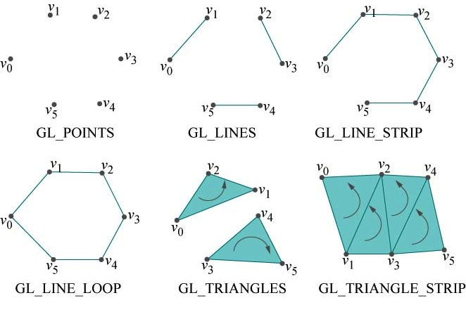
OpenGL Geometric Primitives

Slide 8
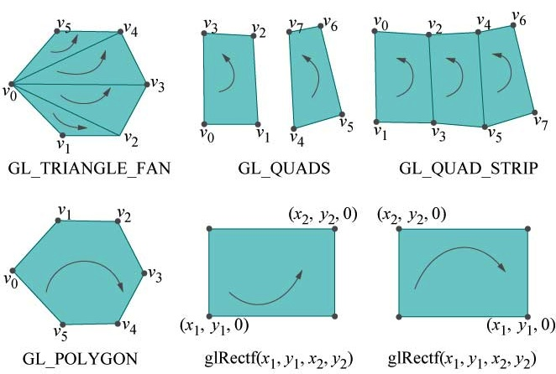
More OpenGL Geometric Primitives

Slide 9
Try some of these primitives in square.cpp
May want to add:
glPointSize(3.0);
to make the points bigger
glLineWidth(4.0):
to make the lines thicker

Slide 10
filled in or outlines using glPolygonMode
glPolygonMode(face, mode)
face can be
GL_FRONT
GL_BACK
GL_FRONT_AND_BACK
mode can be
GL_FILL
GL_LINE
GL_POINT
By default, each face is GL_FILL

Slide 11
Try several triangles, various ways.
Can do
GL_TRIANGLES
GL_TRIANGLE_STRIP
To see triangles can use
glPolygonMode(GL_FRONT_AND_BACK,GL_LINE);
To see filled in and edges, draw twice:
filled in, change color, then outlines.
Notes:
squareV2.cpp part 3, triangle strips.
squareV2.cpp part 4 added to part 3.
Notice Part 4 is above part 3.
Part 5 is fan
Switch from FRONT_AND_BACK to two statements, one FRONT, one BACK
to see if seeing front or back!

Slide 12
Beware of convexity!
Try convexity Example.

